Slide 1
Large-scale Network Design for Accessibility:
A Fast Lagrangian Decomposition Method
Lu Tong, Xuesong Zhou
Arizona State University
Harvey J. Miller
Ohio State University
2014
To be presented at INFORMS 2014
Supported by NSF Project
“Green accessibility: Measuring the environmental costs of space-time prisms in sustainable transportation planning” (BCS-1224102)

Slide 2
Outlines
Accessibility and Time Geography
Accessibility in Space-time Network
A Network Design Model for Accessibility
A Lagrangian Relaxation-based Solution Algorithm
Concluding Remarks and Further Discussion

Slide 3
Accessibility
Accessibility concept
In the general field of transportation land planning, accessibility was early defined by Hansen (1959), as the potential of opportunities for traveler interaction ¹
Accessibility in general refers to the ability for travelers and freight shippers to reach desired activities, destinations and services
Hansen, W. G. (1959). How accessibility shapes land use. Journal of the American Institute of Planners, 25(2), 73-76.

Slide 4
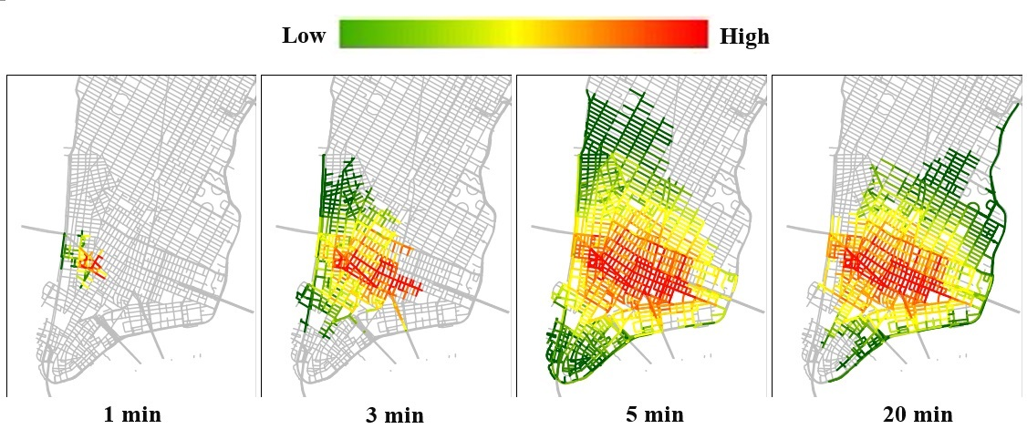
Accessibility
Accessibility concept
Low accessibility
High accessibility
Miller, H, J. (2014). Green Accessibility

Slide 5
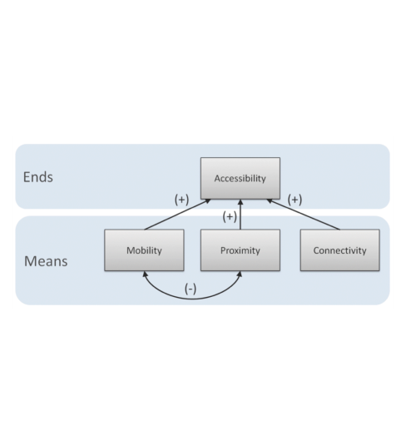
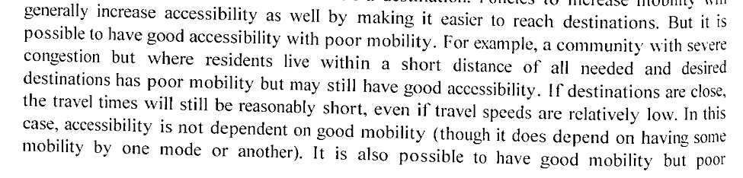
Accessibility
Mobility vs. Accessibility
Planning for mobility means making it easier to travel around (means)
Planning for accessibility means making it easier to get where you need to go (goals)¹
High Mobility—Low Accessibility
Low Mobility—High Accessibility
1 Handy, S. L. (2005). Planning for accessibility: In theory and in practice. In D. M. Levinson & K. J. Krizek (Eds.), Access to Destinations (pp. 131-147). Amsterdam: Elsevier
Graph from: Levine, J., Grengs, J., Shen, Q., & Shen, Q. (2012). Does Accessibility Require Density or Speed? Journal of the American Planning Association, 78(2), 157–172. doi:10.1080/01944363.2012.677119

Slide 6
Time Geography
Space-time path

Slide 7
Time Geography
Space-time prism
(Miller 2005)

Slide 8
Time Geography
Mapping of accessible/ inaccessible locations with respect to potential activity area

Slide 9
Accessibility in Space-time Network
Accessibility concept from origin node to other nodes

Slide 10
Accessibility in Space-time Network
Accessible vs. inaccessible nodes for road users with traveling time constraints

Slide 11
Accessibility in Space-time Network
An illustration of adding a link in physical network

Slide 12

Accessibility in Space-time Network
Build a space-time network for OD pair (o, d)
Step1: Build space-time vertex set $Q$
Add vertex $\left(i,t\right)$ to $Q$ for $i∈N$ and each t.
Step 2: Build space-time arc set $A$
Step 2.1: Add space-time traveling arc $\left(i,t\right), (j,t+TT(i,j,t))$ to$A$, for link $(i,j)∈E$, where $TT\left(i,j,t\right)$ is the link travel time from node i to node j starting at time t.
Step 2.2: Add a set of space-time waiting arcs for a pair of vertexes $\left(o,t\right), \left(o,t+1\right)$ to A, for each time t.
Step 2.3: Add a set of space-time activity-performing arcs for a pair of vertexes $\left(d,t\right), (d,t+T^{A})$ to A, for each time t.
Step 2.4: Add a space-time virtual traveling arc for a pair of vertexes $\left(o,t0\right), (o,t+T)$ to A.
Step 3: Set arc cost structures
Step 3.1: Set $c_{i,j,t,s}\left(o,d\right)=$1 for virtual traveling arcs $(i,j,t,s)∈A^{V}$ .
Step 3.2: Set $g_{i,j,t,s}\left(o,d\right)=1$ for space-time arcs in both sets $A^{A}$ or $A^{V}$.

Slide 13
Accessibility in Space-time Network
An illustration of building space-time arcs
Three nodes: o, d₁ , d₂
Four candidate links: (o, d₁) , (d₁ , o), (d₁, d₂) , (d₂, d₁)
Two OD pairs: (o, d₁), (o, d₂)
Time budget: 7σ
Activity perform time: 2σ
Traveling time on links: 2σ (o↔ d₁), 3σ (d₁ ↔ d₂)

Slide 14
Accessibility in Space-time Network
Step 2.1 Build space-time traveling arcs
Space-time traveling arcs

Slide 15
Accessibility in Space-time Network
Step 2.2 Build space-time waiting arcs
Space-time waiting arcs

Slide 16
Accessibility in Space-time Network
Step 2.3 Build space-time activity-performing arcs
Space-time activity-performing arcs

Slide 17
Accessibility in Space-time Network
Step 2.4 Building space-time virtual traveling arcs
Space-time virtual traveling arcs

Slide 18
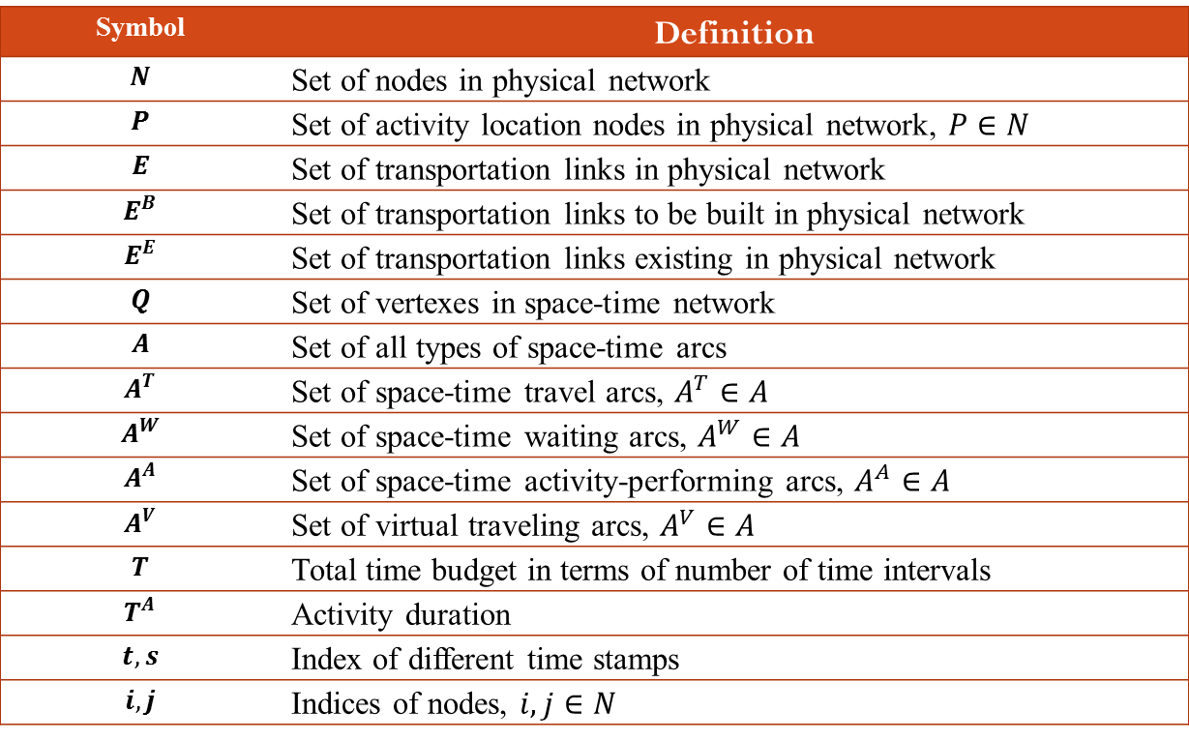
A Network Design Model for Accessibility
Notation
Symbol | Definition
$$N$$ | Set of nodes in physical network
$$P$$ | Set of activity location nodes in physical network, $P∈N$
$$E$$ | Set of transportation links in physical network
$$E^{B}$$ | Set of transportation links to be built in physical network
$$E^{E}$$ | Set of transportation links existing in physical network
$$Q$$ | Set of vertexes in space-time network
$$A$$ | Set of all types of space-time arcs
$$A^{T}$$ | Set of space-time travel arcs, $A^{T}∈A$
$$A^{W}$$ | Set of space-time waiting arcs, $A^{W}∈A$
$$A^{A}$$ | Set of space-time activity-performing arcs, $A^{A}∈A$
$$A^{V}$$ | Set of virtual traveling arcs, $A^{V}∈A$
$$T$$ | Total time budget in terms of number of time intervals
$$T^{A}$$ | Activity duration
$$t, s$$ | Index of different time stamps
$$i,j$$ | Indices of nodes, $i,j∈N$

Slide 19
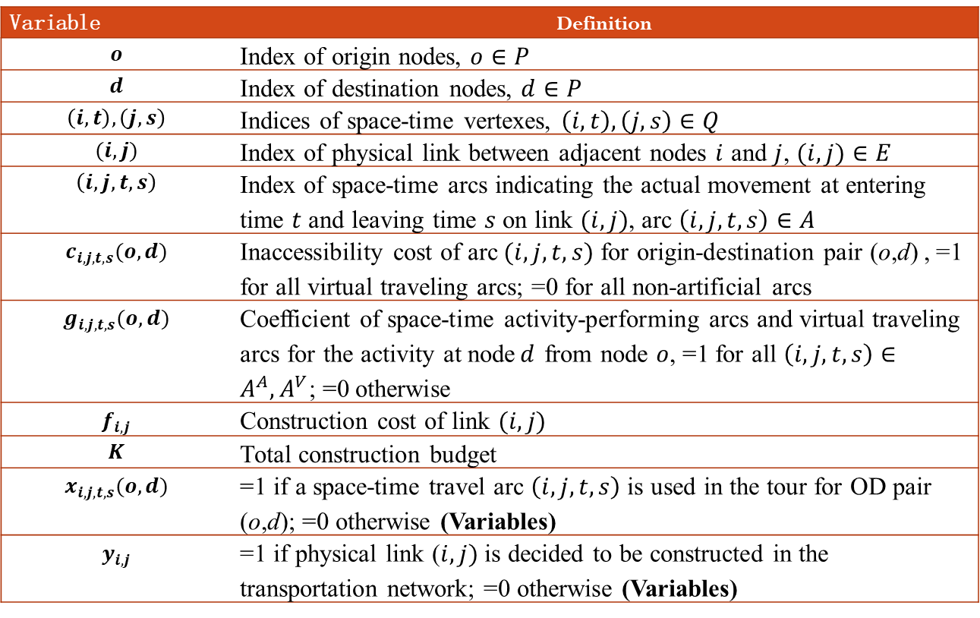
A Network Design Model for Accessibility
Notation
Variable | Definition
$$o$$ | Index of origin nodes, $o∈P$
$$d$$ | Index of destination nodes, $d∈P$
$$\left(i,t\right), \left(j,s\right)$$ | Indices of space-time vertexes, $\left(i,t\right), \left(j,s\right)∈Q$
$$(i,j)$$ | Index of physical link between adjacent nodes $i$ and $j$, $(i,j)∈E$
$$\left(i,j,t,s\right)$$ | Index of space-time arcs indicating the actual movement at entering time $t$ and leaving time $s$ on link $(i,j)$, arc $\left(i,j,t,s\right)∈A$
$$c_{i,j,t,s}(o,d)$$ | Inaccessibility cost of arc$(i,j,t,s)$ for origin-destination pair (o,d) , =1 for all virtual traveling arcs; =0 for all non-artificial arcs
$$g_{i,j,t,s}(o,d)$$ | Coefficient of space-time activity-performing arcs and virtual traveling arcs for the activity at node$d$ from node $o$, =1 for all $\left(i,j,t,s\right)∈A^{A},A^{V}$; =0 otherwise
$$f_{i,j}$$ | Construction cost of link $(i,j)$
$$K$$ | Total construction budget
$$x_{i,j,t,s}(o,d)$$ | =1 if a space-time travel arc $\left(i,j,t,s\right)$ is used in the tour for OD pair (o,d); =0 otherwise (Variables)
$$y_{i,j}$$ | =1 if physical link ($i,j)$ is decided to be constructed in the transportation network; =0 otherwise (Variables)

Slide 20
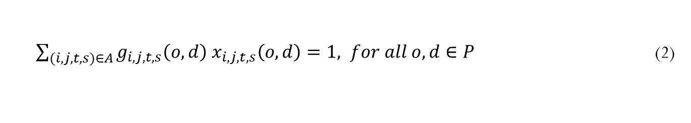
A Network Design Model for Accessibility
Space-time flow balance constraints
Activity constraints
$\sum_{\left(j,s\right)∈Q}{x_{i,j,t,s}(o,d)}−\sum_{\left(j,s\right)∈Q}{x_{j,i,s,t}(o,d)}=\left\{\begin{aligned}1, i=o,t=t_{0} \\ −1, i=d,t=t_{0}+Tσ \\ 0, otherwise\end{aligned}\right.$ $for all o,d∈P$
(1)
$\sum_{(i,j,t,s)∈A}{g_{i,j,t,s}\left(o,d\right){ x}_{i,j,t,s}\left(o,d\right)}=1, for all o,d∈P$ (2)

Slide 21
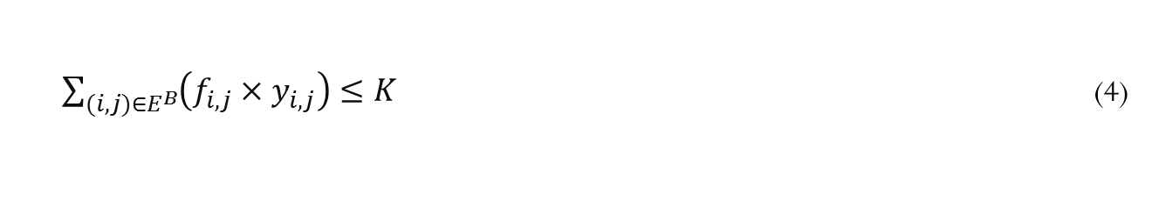

A Network Design Model for Accessibility
Coupling constraints between space-time arcs and physical links
Construction budget constraint
Other constraints
$x_{i,j,t,s}\left(o,d\right)≤y_{i,j}, for all o,d∈P, \left(i,j,t,s\right)∈A,\left(i,j\right)∈E^{B}$ (3)
$\sum_{(i,j)∈E^{B}}{\left(f_{i,j}{×y}_{i,j}\right)}≤K$ (4)
$x_{i,j,t,s}^{o,d}∈\left\{0,1\right\} for all o,d∈P, (i,j,t,s)∈A$
$$y_{i,j }∈\left\{0,1\right\} for all (i,j)∈E^{B}$$

Slide 22
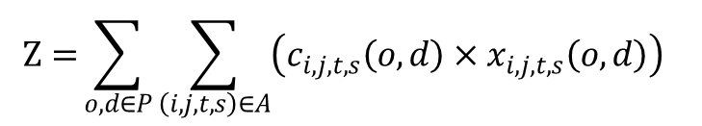
A Network Design Model for Accessibility
Objective function
Maximize accessibility（minimize inaccessibility）
$$Z={\sum_{o,d∈P}{\sum_{\left(i,j,t,s\right)∈A}{\left(c_{i,j,t,s}\left(o,d\right)×x_{i,j,t,s}\left(o,d\right)\right) }}}$$
(5)

Slide 23

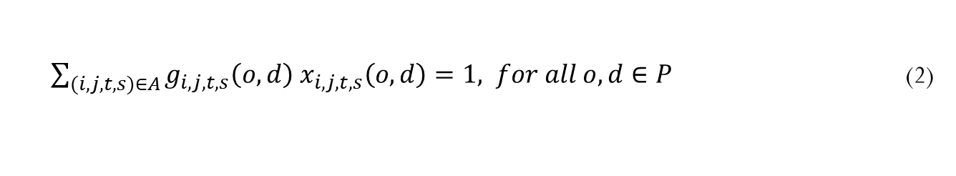
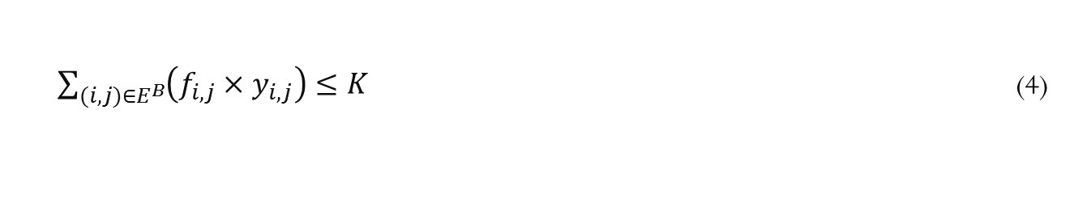
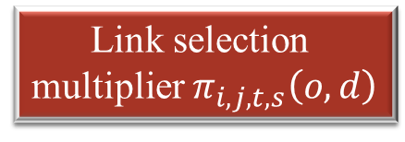
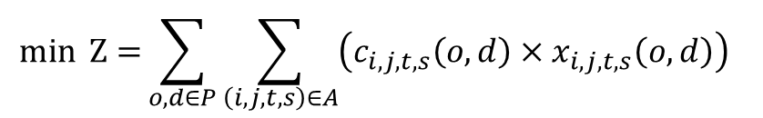
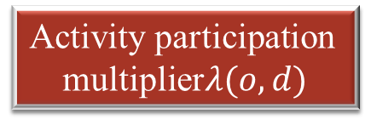
A Lagrangian Relaxation-based Solution Algorithm
Hard constraints
$$min Z={\sum_{o,d∈P}{\sum_{\left(i,j,t,s\right)∈A}{\left(c_{i,j,t,s}\left(o,d\right)×x_{i,j,t,s}\left(o,d\right)\right) }}}$$
obj.
(5)
s.t.
Activity participation
multiplier$λ(o,d)$
Link selection
multiplier $π_{i,j,t,s}\left(o,d\right)$
$\sum_{\left(j,s\right)∈Q}{x_{i,j,t,s}(o,d)}−\sum_{\left(j,s\right)∈Q}{x_{j,i,s,t}(o,d)}=\left\{\begin{aligned}1, i=o,t=t_{0} \\ −1, i=d,t=t_{0}+Tσ \\ 0, otherwise\end{aligned}\right.$ $for all o,d∈P$
(1)
$\sum_{(i,j,t,s)∈A}{g_{i,j,t,s}\left(o,d\right){ x}_{i,j,t,s}\left(o,d\right)}=1, for all o,d∈P$ (2)
$x_{i,j,t,s}\left(o,d\right)≤y_{i,j}, for all o,d∈P, \left(i,j,t,s\right)∈A,\left(i,j\right)∈E^{B}$ (3)
$\sum_{(i,j)∈E^{B}}{\left(f_{i,j}{×y}_{i,j}\right)}≤K$ (4)
$x_{i,j,t,s}^{o,d}∈\left\{0,1\right\} for all o,d∈P, (i,j,t,s)∈A$
$$y_{i,j }∈\left\{0,1\right\} for all (i,j)∈E^{B}$$

Slide 24


A Lagrangian Relaxation-based Solution Algorithm
Lagrangian relaxation problem
$$\sum_{o,d∈P}{\sum_{\left(i,j,t,s\right)∈A}{\left(c_{i,j,t,s}\left(o,d\right)×x_{i,j,t,s}\left(o,d\right)\right)}}$$
$$+\sum_{o,d∈P}{λ(o,d)\left(1−\sum_{\left(i,j,t,s\right)∈A}{g_{i,j,t,s}\left(o,d\right){ x}_{i,j,t,s}\left(o,d\right)}\right)}$$
$$−\sum_{o,d∈P}{\sum_{\left(i,j,t,s\right)∈A}{π_{i,j,t,s}\left(o,d\right)\left(y_{i,j}−{ x}_{i,j,t,s}\left(o,d\right)\right)}}$$
$$L=$$
(6)
s.t. Constraints (1) and (4) and binary constraints for X and Y

Slide 25
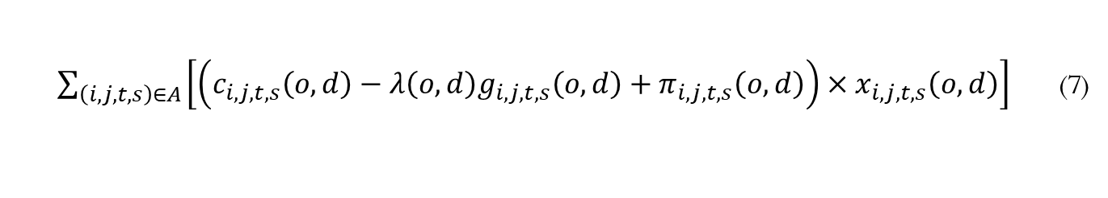

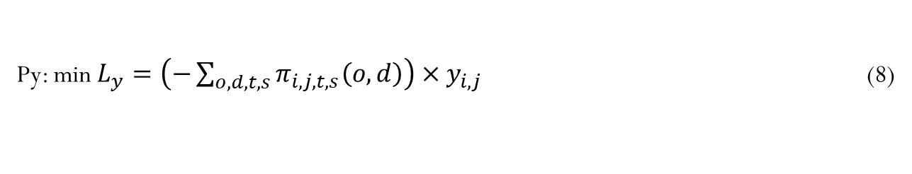
A Lagrangian Relaxation-based Solution Algorithm
Lagrangian relaxation problem decomposition
Subproblem 1: Time-dependent least cost path subproblems for each OD pair
Subproblem 2: Knapsack problem
P_{X}: min${L_{X}}_{o,d}=$
$\sum_{\left(i,j,t,s\right)∈A}{\left[\left(c_{i,j,t,s}\left(o,d\right)−λ\left(o,d\right)g_{i,j,t,s}\left(o,d\right)+π_{i,j,t,s}\left(o,d\right)\right)×x_{i,j,t,s}\left(o,d\right)\right]}$ (7)
Py: min $L_{y}=\left(−\sum_{o,d,t,s}{π_{i,j,t,s}\left(o,d\right)}\right){×y}_{i,j}$ (8)

Slide 26
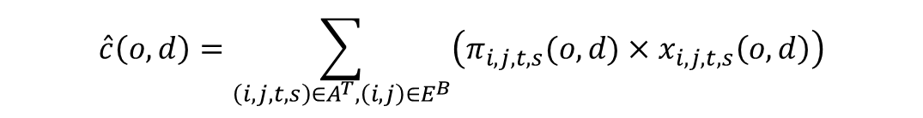
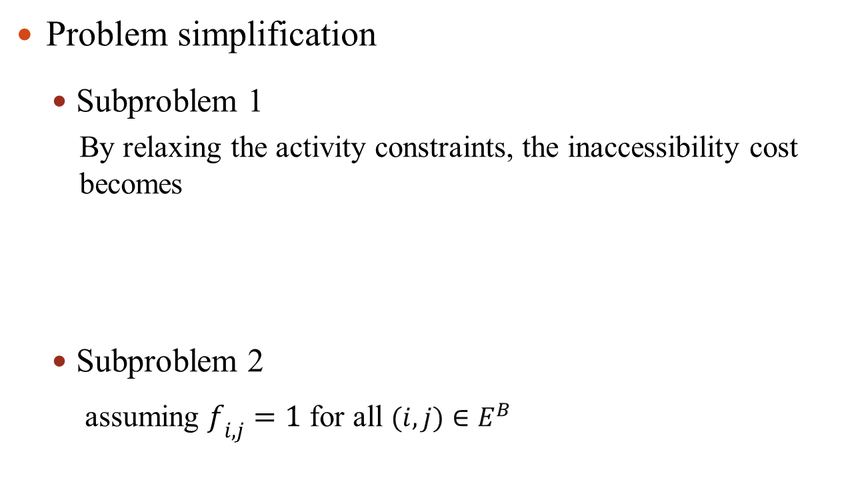
A Lagrangian Relaxation-based Solution Algorithm
Problem simplification
Subproblem 1
By relaxing the activity constraints, the inaccessibility cost becomes
Subproblem 2
assuming $f_{i,j}=1$ for all $(i,j)∈E^{B}$
$$\hat{c}\left(o,d\right)=\sum_{\left(i,j,t,s\right)∈A^{T},\left(i,j\right)∈E^{B}}{\left(π_{i,j,t,s}(o,d)×x_{i,j,t,s}\left(o,d\right)\right)}$$

Slide 27

A Lagrangian Relaxation-based Solution Algorithm
Lagrangian relaxation-based algorithm for solving simplified problem
Step 1: Initialization
Set iteration number k = 0;
Choose positive values to initialize the set of Lagrangian multipliers $π_{i,j,t,s}(o,d)$;
Step 2: Solve decomposed dual problems
Solve subproblem P_{x} using a standard time-dependent shortest path algorithm and find a path solution X(o,d) for each OD pair (o,d)
Solve subproblem P_{y} and find a value for Y;
Calculate primal, dual and gap values.

Slide 28

A Lagrangian Relaxation-based Solution Algorithm
Lagrangian relaxation-based algorithm for solving simplified problem
Step 3: Update Lagrangian multipliers
Update Lagrangian multipliers $π_{i,j,t,s}(o,d)$ using subgradient $\left(y_{i,j}−{ x}_{i,j,t,s}\left(o,d\right)\right)$
Step 4: Termination condition test
If k is less than a predetermined maximum iteration value, or the gap is smaller than a predefined toleration gap, terminate the algorithm, otherwise k=k+1 and go back to Step 2.

Slide 29
A Lagrangian Relaxation-based Solution Algorithm
Primal problem
Update Lagrangian multipliers
Lagrangian multipliers
Lagrangian dual problem
Subproblem 1:
least cost path problems
Subproblem 2:
Kanpsack problem
Calculate Lagrangian multipliers using subgradient method
No
Yes
Termination condition test
Output the primal, dual and gap values

Slide 30

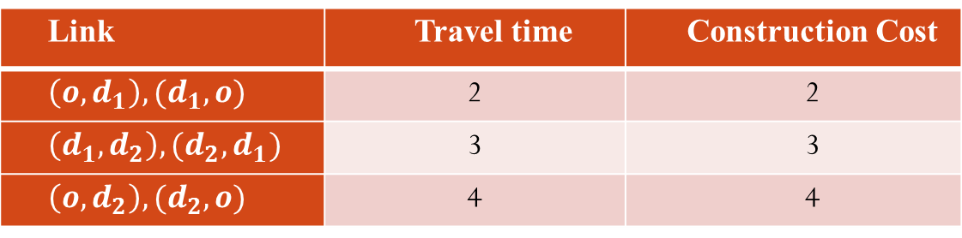


A Lagrangian Relaxation-based Solution Algorithm
Three-node network illustration
Link | Travel time | Construction Cost
$$\left(o,d_{1}\right),(d_{1},o)$$ | 2 | 2
$$\left(d_{1},d_{2}\right),(d_{2},d_{1})$$ | 3 | 3
$$\left(o,d_{2}\right), (d_{2},o)$$ | 4 | 4
$$d_{2}$$
$$o$$
$$d_{1}$$

Slide 31
A Lagrangian Relaxation-based Solution Algorithm
Three-node network illustration—impact of construction budget

Slide 32
A Lagrangian Relaxation-based Solution Algorithm
Three-node network illustration—impact of travel time budget (under 10-unit construction budget)

Slide 33
A Lagrangian Relaxation-based Solution Algorithm
Three-node network illustration—impact of link travel time (under 10-unit construction budget and 10 time units of travel time budget)

Slide 34
A Lagrangian Relaxation-based Solution Algorithm
Illustration of Lagrangian Multiplier
time budget = 3, total construction link number = 3
OD pair (1->4) ）

Slide 35
A Lagrangian Relaxation-based Solution Algorithm
Illustration of Lagrangian Multiplier
time budget = 3, total construction link number = 3

Slide 36
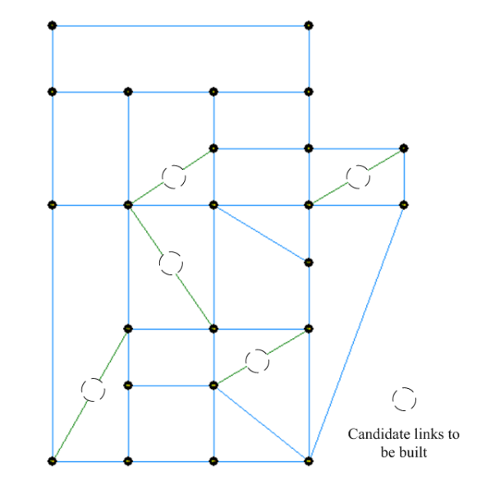
A Lagrangian Relaxation-based Solution Algorithm
Medium-scale experiments—Sioux Falls
A simpliﬁed Sioux Falls network consisting of 24 nodes and 76 directional links, with 10 directional optional links to be selected

Slide 37
A Lagrangian Relaxation-based Solution Algorithm
Medium-scale experiments—Sioux Falls
Evolution of upper bound and lower bound values for different travel time budgets, LB: Lower bound, UB: Upper bound, and each time series is labeled as LB_TTB or UB_TTB for TTB =19,18, and 16 min, number of links to be constructed K = 3

Slide 38
A Lagrangian Relaxation-based Solution Algorithm
Medium-scale experiments—Sioux Falls
Evolution of relative optimality gap ((UB-LB/UB) travel time budget TTB =12 min, # of links to be selected K = 4, 5 and 6

Slide 39
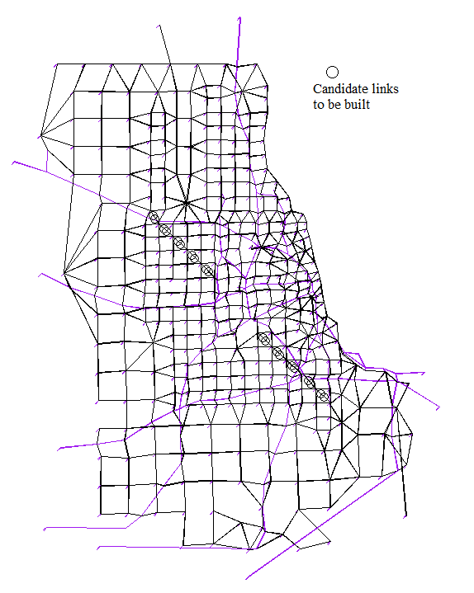
A Lagrangian Relaxation-based Solution Algorithm
Large-scale experiments—Chicago
The Chicago region has 387 zones and 2950 links, with 20 directional optional links to be selected

Slide 40
A Lagrangian Relaxation-based Solution Algorithm
Large-scale experiments—Chicago
Iteration No. | Cumulative CPU time (mm:ss) | Lx | Ly | L in Eq. (6) | LB (as Best L) | UB | Relative Gap (%)
1 | 1:36 | 31684.0 | 0.0 | 31684.0 | 31684.0 | 149382 | 78.8%
2 | 5:42 | 32489.5 | -3536.3 | 28953.3 | 31684.0 | 33260 | 4.7%
3 | 9:48 | 32722.3 | -2520.6 | 30201.7 | 31684.0 | 32898 | 3.7%
4 | 13:54 | 32869.6 | -2036.7 | 30832.9 | 31684.0 | 32898 | 3.7%
5 | 18:00 | 32959.4 | -1635.9 | 31323.5 | 31684.0 | 32898 | 3.7%

Slide 41
Conclusion
Accessibility is an important performance measure which is often neglected in transportation network design models
A linear integer programming model is presented to maximize end-to-end accessibility within space-time constraints
A Lagrangian relaxation based solution method is developed to solve this problem in real-world applications

Slide 42
Further discussions
Path-based network design approach for accessibility
Multi-model network design problem
Railroad network planning
Urban rail transit network design
Unban public transportation service network design

